Slide 1

IMPACT OF VEHICLE AERODYNAMICS ON FUEL EFFICIENCY
A Technical Case Study of the 2015 Honda Accord Hybrid
By: David Obakin and MichAel Hatzis

Slide 2
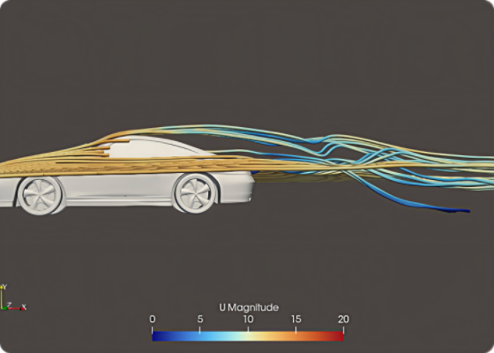
Background: Energy Loss in Motion
As vehicle speeds increase, the energy required to overcome environmental resistance grows exponentially. While engine efficiency and weight reduction are critical, aerodynamics becomes the dominant factor at highway velocities.
Aerodynamic drag is responsible for ~60% of total highway energy loss.
Minimizing drag coefficients (Cd) is the "low hanging fruit" for extending range and MPG.

Slide 3


Background: The Physics of Drag
The resistive force of air on a moving body is defined by the Drag Equation. Note the square of velocity, which dictates that fuel consumption penalties increase drastically as speed climbs.
Key Implications:
Power Requirement: Since Power = Force × Velocity, the power needed to overcome drag increases at a rate proportional to the cube of speed (v^3).
Frontal Area (A): Fixed by the vehicle's footprint.
Drag Coefficient (Cd): The primary variable that can be optimized through design.
Where: ρ = air density, v = velocity, Cd = drag coefficient, A = frontal area.

Slide 4
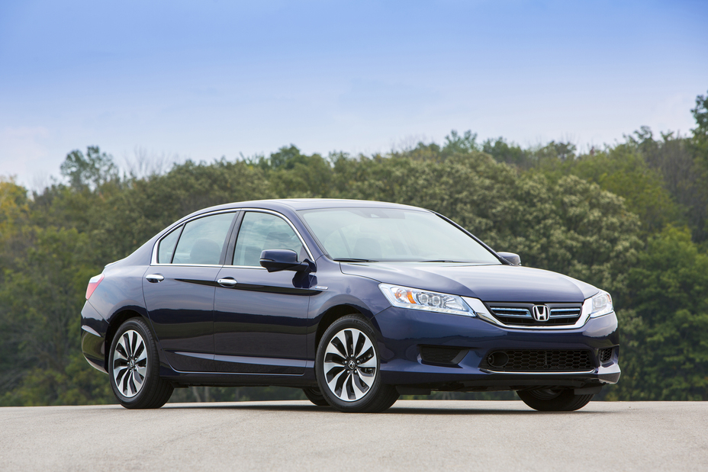
Vehicle Selection: 2015 Honda Accord Hybrid
Why the Accord Hybrid? The 9th Gen Accord Hybrid represents a standard for mid-size efficiency. It utilizes advanced Atkinson-cycle engine technology and specific aerodynamic enhancements like active grille shutters and flat underbody panels.
Weight: 3,550 lbs (~1,610 kg) Frontal Area: ~2.26 m² Drag Coefficient: ~0.28 Drivetrain: 2.0L i-VTEC + Two-Motor Hybrid System
Notes:
We decided to model the 9th Generation 2015 Honda Accord Hybrid for a few key reasons. First, it’s a standard for mid-size efficiency, making our data highly applicable to everyday driving. Second, it features a 2.0L Two-Motor Hybrid system. Because the hybrid system is so efficient in stop-and-go city traffic, it highlights just how much energy is lost to aerodynamic drag once you hit highway speeds.
Finally, this car was built with aerodynamics in mind. It comes factory-equipped with active grille shutters and flat underbody panels, resulting in a drag coefficient of 0.28 and a frontal area of 2.26 square meters. We will be using these exact specifications as the baseline in our Excel model to see how further altering that drag coefficient impacts overall energy consumption.

Slide 5



Background: Hybrids vs. Aerodynamics
Regen Braking Hybrid systems mitigate the energy loss of high vehicle mass during stop-and-go city driving via regeneration.
Aerodynamic Cap
Regeneration cannot recover energy lost to air friction. Thus, as the powertrain becomes more efficient, drag becomes the ultimate efficiency cap.
Steady-State
On highways, the battery buffer is less relevant. The engine must fight a constant "wind wall," making Cd the critical variable.
Notes:
This slide illustrates the unique relationship between hybrid powertrains and aerodynamics. We all know hybrids get great city mileage; this is because regenerative braking mitigates the energy loss of accelerating and decelerating a heavy vehicle.
But aerodynamics represent a hard limit. Unlike braking, you cannot recapture the energy you spend pushing air out of the way. As automakers make engines and batteries more efficient, air friction becomes the dominant source of energy loss.
This is especially true on the highway. When we look at aggressive highway cruising, such as the US06 drive cycle we are using for our model, the battery isn't helping much because there are fewer stops. The car reaches a steady state where the engine is primarily just fighting aerodynamic drag. That is exactly why our project zeroes in on the drag coefficient (Cd)—at highway speeds, it is the most critical variable for improving hybrid efficiency.

Slide 6
Part II: Project Scope
Defining Objectives, Parameters, and Methodology

Slide 7



Scope: Research Objectives
Sensitivity Analysis Quantify how precise increments in Cd (drag coefficient) correlate with MPG reductions in the US06 cycle.
Technical Modelling
ReBuild a high-fidelity Excel model simulating the 2015 Accord's tractive effort requirements at 1Hz frequency.
Energy Attribution
Analyze the percentage contribution of drag vs. overall road load at different speeds (30 MPH vs. 70 MPH).
Notes:
To execute this project, we broke our scope down into three specific research objectives which answer What we are doing, How we are doing it and Why we are doing it.
Our first goal is a Sensitivity Analysis, The What. We want to quantify the relationship between aerodynamics and fuel economy. By incrementing the drag coefficient (Cd) up and down, we can track the exact MPG penalties or gains over the aggressive US06 drive cycle.
To do this accurately, our second objective was Technical Modeling Our Why. We built a dynamic Excel model that simulates the 2015 Accord's tractive effort requirements. Because the US06 cycle has rapid acceleration and deceleration, we set our model to calculate the physics at a 1Hz frequency—meaning we evaluate the forces acting on the car every single second.
Finally, we are looking at Energy Attribution the Why speed matters. We know aerodynamics matter more at higher speeds, but we want to prove it mathematically. Our model will isolate aerodynamic drag from overall road load to compare its percentage contribution at a city speed of 30 MPH versus a highway speed of 70 MPH.

Slide 8
Scope: Variable Parameters (Cd)
0.20 - 0.35
Testing Scenarios
Ultra-Aero (0.20): Simulating mods like fender skirts or boat tails. Most aerodynamic design.
Baseline (0.28): The standard factory 2015 Honda Accord Hybrid. General standard for modern sedans.
Degraded (0.35): Simulating roof racks, windows down, or high-drag tires.
Drag Coefficient Range

Slide 9
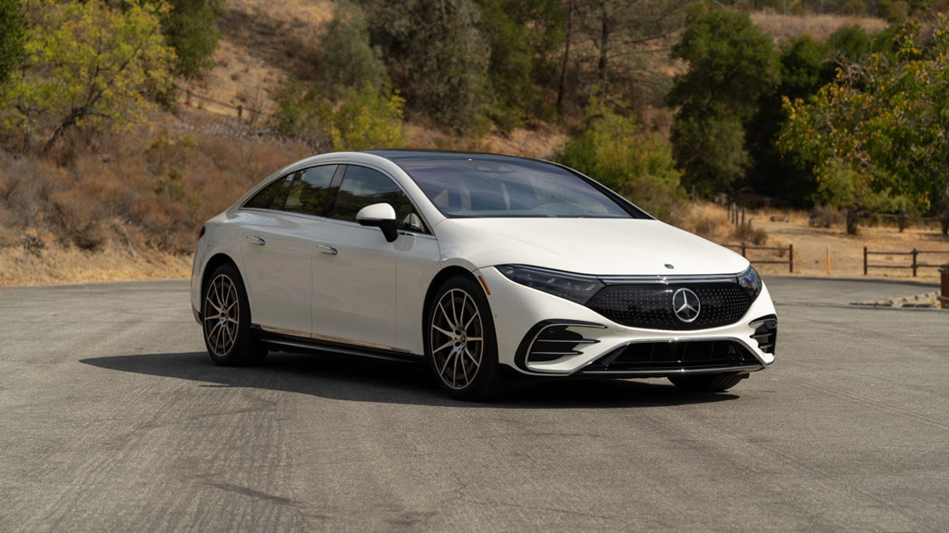

Coefficient of Drag Examples
Excellent Aerodynamic Design
Average Aerodynamic Design
Subpar Aerodynamic Design
Car: 2022 Mercedes-Benz EQS
Drag Coefficient=0.2
Car: 2015 Honda Accord Hybrid
Drag Coefficient=0.28
Car: 2021 Kia Soul EV
Drag Coefficient=0.35

Slide 10
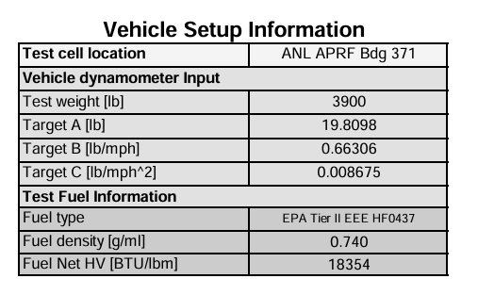
Scope: Modeling Methodology
The Excel Power Model
The aerodynamic force was found using the c coefficient.
The force, power, and energy was found.
The data from Argonne was used to find initial fuel efficiency.
C was varied to simulate differences in coefficient of drag and frontal area.
Increased and decreased by a factor of 25%
Isolated high-speed conditions to compare with overall cycle.

Slide 11
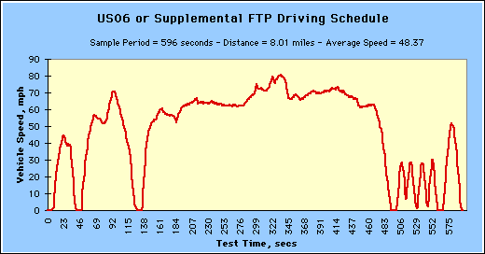
Scope: US06 Drive Cycle Analysis
Cycle Focused: Our analysis focuses strictly on the US06 cycle, which emphasizes high-speed cruising where aero drag is most impactful

Slide 12

Scope: Speed vs. Energy Attribution
Contribution Factors
Aerodynamic Drag (50%-70%): The dominant resistive force at highway cruising speeds.
Key Metric: We will track how this ratio flips as speed decreases to 30 MPH.
70 MPH Energy Split

Slide 13
Technical Analysis & Excel Modeling Phase
Drag Sensitivity Results & Efficiency Conclusions

Slide 14
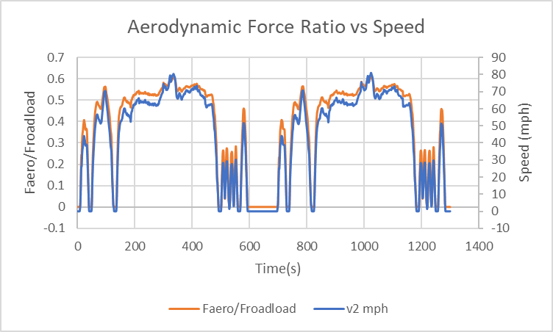
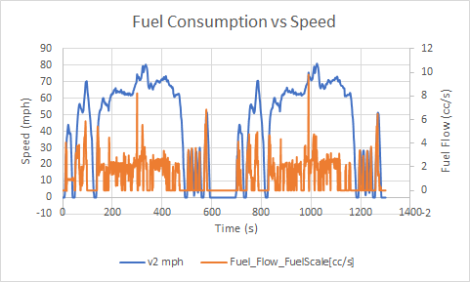
Data Results
The percentage of the force from aerodynamics increases as the speed increases
The Drag force made up a higher percentage of total road load force at higher c coefficient
Fuel consumption was higher as speed increased, and lower when speed is steady or decreasing

Slide 15
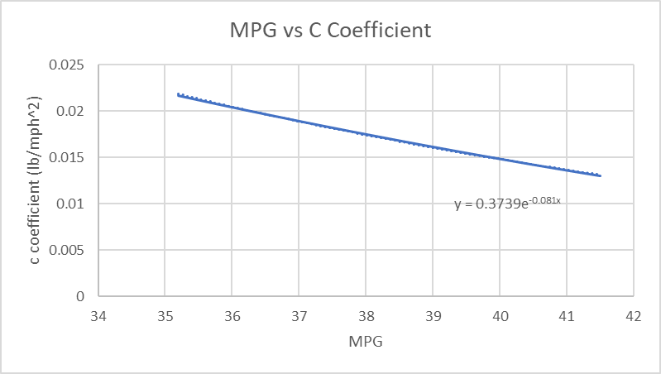
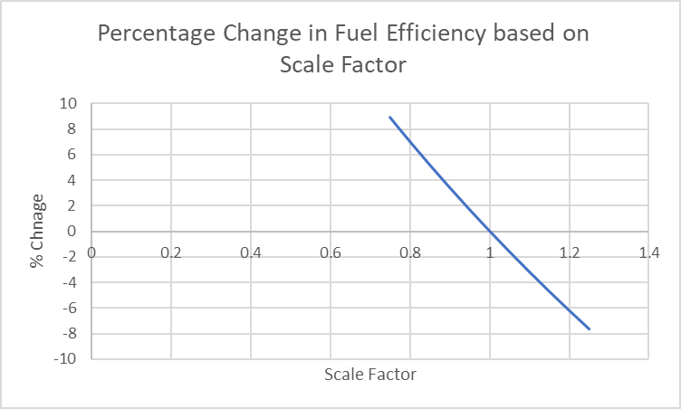
Data Results
The MPG was found to decrease as the C coefficient became larger. This would correspond with a larger drag coefficient.
Decreasing the c coefficient by a 10% yielded a 3.4% increase in fuel efficiency. This would be comparable to decreasing the drag coefficient to around 0.25

Slide 16
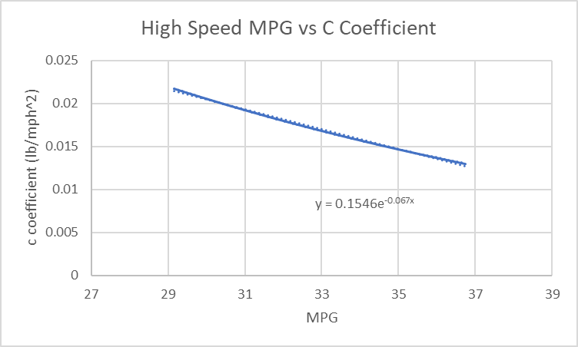
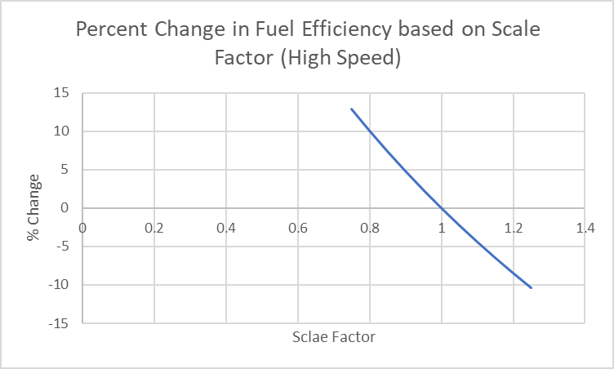
Data Results
The average MPG for speeds above 60 mph was lower than the overall average.
For high speeds decreasing the c coefficient by a 10% yielded a 4.8% increase in efficiency. Reducing c by 25% would result in a 12.9% increase in efficiency

Slide 17
Efficiency Conclusions
The ratio of aerodynamic force to overall road load force is proportional to the speed
Fuel consumption is higher at higher speeds and when accelerating
The fuel efficiency increases as the aerodynamic force decreases
Done through altering the frontal area or coefficient of drag
When looking at high speed scenarios, reducing the aerodynamic force on the vehicle produces greater efficiency improvements.
Some of the limitations of this model is that it relies on the C coefficient to find the aerodynamic force. This can cause the force to be slightly lower than expected. This was adjusted for by using online information about the Accord's drag coefficient to accurately capture the fuel efficiency effects.

Slide 18
How to Reduce Aerodynamic Force
Improve the Coefficient of Drag – This involves optimizing the design of the vehicle.
Rounding the edges of the front of the car to emulate teardrop shape
Taper the back of the car
Adding boat tails or spoilers to the back of the car
Reduce the ground clearance
Decrease the Frontal Area – Decreasing the frontal area means the car will have to displace less air when driving.

Slide 19
References
OnlineWindTunnel.jpg (1966×1194)
https://img2.carmax.com/assets/27384724/hero.jpg?width=400&height=300
2015 Accord Hybrid Specifications & Features
2022 Mercedes-Benz EQS second drive review: The S-Class of EVs - CNET
2015 Honda Accord Hybrid Touring
SUV Review: 2021 Kia Soul EV Limited - Driving.ca | Driving
us06dds.gif (520×272)

